Slide 1
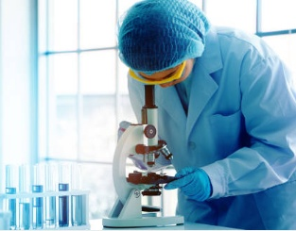
History of Microbiology
By
Mrs. Savita Chandrawanshi
Asstt. Professor, Department of Microbiology
Govt. Digvijay Autonomous PG College, Rajnandgaon.

Slide 2
Micobiology
Microbiology is a specialized area of biology that deals with the study of microorganism.
Organisms with a diameter of 1mm or less are microorganisms.
Microorganisms are the organisms that are too small to be seen with the unaided eye and a microscope is needed to see them.

Slide 3
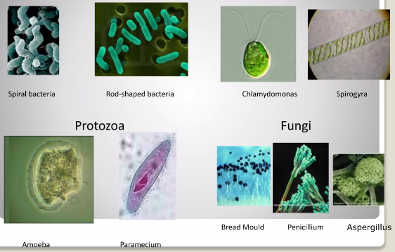
Bacteria
Algae

Slide 4
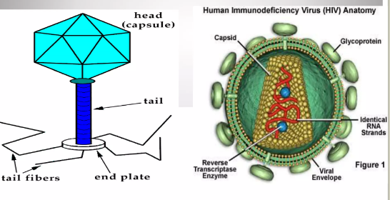
Virus

Slide 5
Types of Microorganism
bacteria, archaea, algae, fungi, protozoa viruses.
Cellular
Unicellular (eg.Bacteria) or multicellular(eg.Fungi)
Prokaryotic or Eukaryotic
Acellular- eg.Viruses

Slide 6
Types of Microbiology
Bacteriology
Mycology
Phycology
Protozoology

Slide 7
Branches of Microbiology
Bacteriology: study of bacteria- smallest, simplest, prokaryotic, single-celled microorganism.
Mycology: study of fungi – hetrotrophic, eukaryotic, spore- bearing microorganisms. Eg: molds, yeast
Protozoology: study of protozoans- animal like and mostly single celled eukaryotic organisms.
Phycology: study of Algae- simple aquatic organisms ranging single celled form large sea weeds.

Slide 8
Virology: study of viruses- ultramicoscopy noncellular .

Slide 9
Scope of microbiology
Industrial microbiology- concerned with the industrial uses of microbes in the production of alcoholic beverages, vitamins, amino acids, enzymes, antibiotics and other drugs.
Agriculture microbiology- relationship of microbes and crops , control of plant diseases and improvement of yield.
Food microbiology - food bio processing, food spoilage, food borne diseases and their prevention.

Slide 10
Dairy microbiology- many dairy products are manufactured. cheese, yogurt, buttermilk etc.
Immunology: The study of immune system which protect the body from pathogens.
Microbial ecology – biogeochemical cycles – bioremediation to reduce pollution effects.
Genetic engineering – arisen from work of microbial genetics and molecular biology. Engineered microorganisms are used to make hormones, antibiotics, vaccines and other products. New genes can be inserted into plants and animals.

Slide 11
History of Microbiology
Discovery Era
Transition Period
The Golden Age
In 20th Century: Era of Molecular Biology

Slide 12
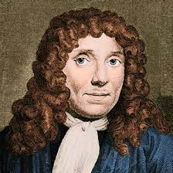
Discovery Era
This period concerns with the discovery of microbial world that has been dominated by Antony van Leeuwenhoek.
Rogen Bacon- disease is produced by invisible living creatures.

Slide 13
In 1665, Robert Hooke, an English scientist, was the first to use a lens to observe the smallest unit of tissues he called ‘’cells’’.
Antony van Leeuwnhoek – first person to observe and accurately describe microorganisms(bacteria, protozoa) called “animalcules’’.
He was a Dutch lines merchant but spent much of his spare time constructing simple microscopes composed of double convex lenses .

Slide 14
constructed over 250 small powerful microscopes that could magnify around 50 to 300 times.
Leeuwenhoek was the first person to produce precise and correct descriptions of bacteria and protozoa using a microscope he made himself. Because of this extraordinary contribution to microbiology, Antonie van Leeuwenhoek is considered as the “Father of microbiology”.
Antonie van Leeuwenhoek is also considered to be the father of bacteriology and protozoology .

Slide 15
Transition Period
Spontaneous Generation versus Biogenesis
When microorganisms were known to exist, most scientists believed that such simple life forms could develop form non-living matter(abiogenesis).

Slide 16
Francesco redi(1626-1697):
The ancient belief in spontaneous generation was first of all challenged by Redi, an italian physician, who carried out a series of experiments on decaying meat and its ability to produce maggots spontaneously.

Slide 17
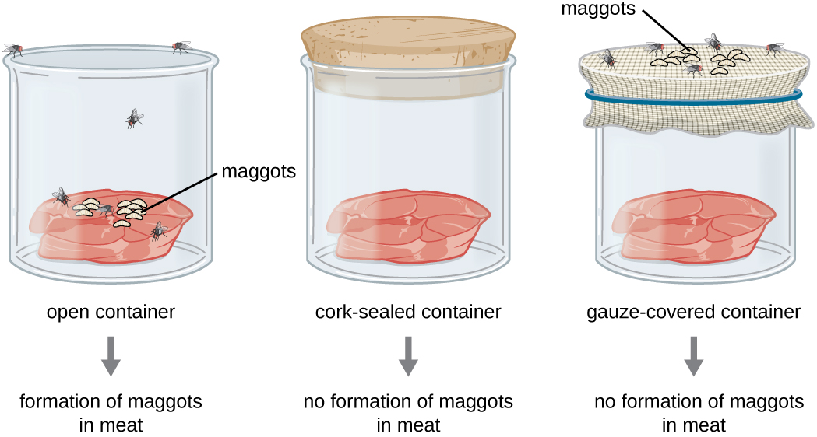

Slide 18
John Needham(1713-1781)
He was probably the greatest supporter of the theory of spontaneous generation.
He proposed that tiny organisms, the animalcules arose spontaneously on his mutton gravy.
He had covered the flasks with cork as done by Redi and even heated some flasks. Still the microbes appeared on mutton broth.

Slide 19
Lazzaro Spallanzani
Spallanzani in 1775 disproved the doctrine of spontaneous genration.
Attempted to refuse Needham’s work by performing extensive experiments.
He boiled beef broth for longer period, removed the air from the flask and then sealed the container.
Following incubation, no growth was observed by him in these flasks.

Slide 20
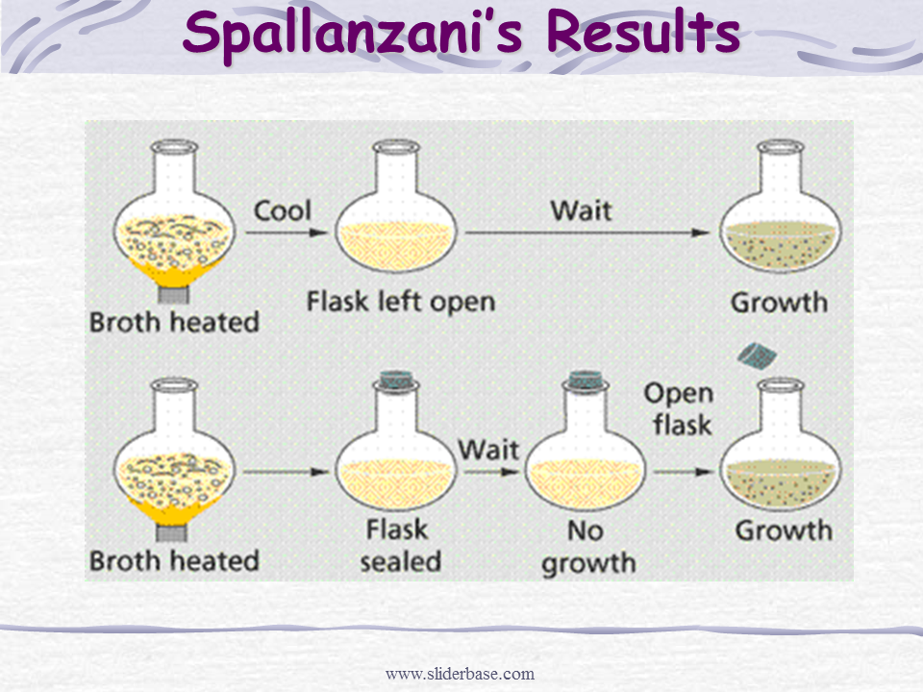

Slide 21
Franz Schulze and Theodor Schwann
who were of the view that air was the source of microbes and sought to prove this by passing air through hot glass tubes or strong chemicals into boiled infusions in flasks.
But, advocates of spontaneous generation were still not convinced and said that the treatment of air by acid or heat had altered the air so that it would not support growth.

Slide 22
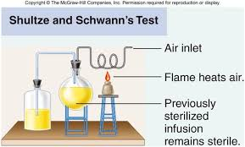

Slide 23
Georg Schroeder and Theodor Von
In 1854, performed experiments to disprove the theory of spontaneous generation by simply passing air through cotton into flasks containing heated broth.
No growth of microbes was observed on the infusions due to the filtering out of microscopic organisms by cotton.

Slide 24
Thank You

